Slide 1
Who do you admire?

Slide 2
Correct the factual mistakes if there are some (True; false)
Yuri Gagarin was the first to orbit the Earth.
Christopher Columbus was the third to come to the Central America.
Neil Armstrong was the second to step onto the moon.
Sergei Bondarchuk was the only Russian film maker to get an Oscar for his film.
Leif Ericsson was the last European to land in North America.
Valentina Tereshkova was the first woman-cosmonaut in the world.

Slide 3
Relative clauses with WHOSE
Когда мы хотим сообщить информацию, характеризующую или определяющую действия, совершаемые кем-либо, мы можем использовать придаточное определительное предложение с союзным словом WHOSE(чей-либо, чья-либо):
I like people whose ideas can change the world.
Мне нравятся люди, чьи идеи могут изменить мир.

Slide 4
Match the names of the people with their achievements:
Steven Spielberg is a famous film director whose… David Beckham is a football player whose… Madonna is a famous pop star whose… Pushkin was a great Russian poet whose… Isaac Levitan was a famous artist whose… Nicolas Cage is a Hollywood star whose… Princess Diana was a person whose… | a) …pictures show us the beauty of the Russian nature. b) …films are popular. c) …charms were admired by people all over the world. d) …playing is brilliant. e) …acting is perfect. f) …singing is magic. g) …poems are really wonderful.

Slide 5
Change the sentence using Infinitive as an attribute
E.g.: Mary: I want to orbit Mars. (the first).
Mary wants to be the first to orbit Mars.
Laura: I want to save people from troubles. (the only)
Tom: I want to cure people with cancer. (the first)
Rick: I want to win all the tennis championships.(the only)
Paul: I want to organize a large town in space. (the first)
Helen: I want to invent a medicine for AIDS. (the first)

Slide 6
Painting in England in the 17-19th centuries.
Painting in England in the 17-19th centuries is represented by a number of great artists. William Hogarth was the first English painter who developed the British art. His most popular form of painting became ceremonial portraits of representatives of the ruling class.
Sir Joshua Reynolds was the most outstanding portraitist of the second half of the 18th century. He became the first president of the Royal Academy.
Thomas Gainsborough, another greatest master, was portraitist and landscape painter. He was the first to paint English landscapes.
Joseph Turner was an outstanding artist whose favourite topic was to paint sea. He painted storms and waves with great skills. All their paintings are displayed in the National Gallery, the National Portrait Gallery and the Tate Gallery. Millions of tourists enjoy the world-famous pictures each year.

Slide 7
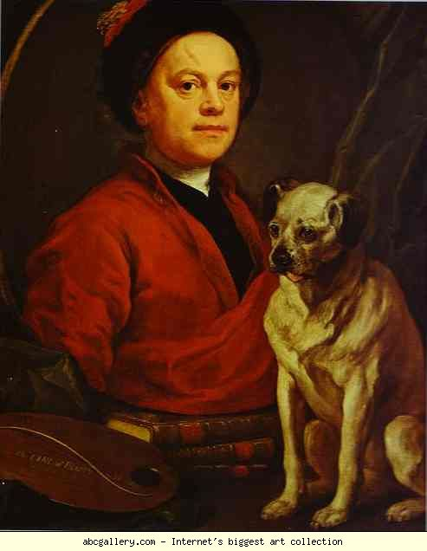
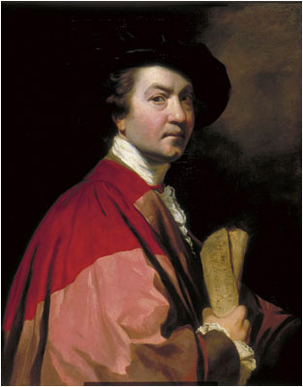
Sir Joshua Reynolds
William Hogarth

Slide 9
Find in the text all the sentences with Infinitive as an attribute and read them aloud. (the first, the last)
Find in the text all the sentences with the relative clause with WHOSE.

Slide 10
Answer my questions:
a) Was William Hogarth the last English painter who developed the British art?
b) Who was the first president of the Royal Academy?
c) Who was the first to paint English landscapes?
d) Did William Hogarth or Sir Joshua Reynolds paint portraits of representatives of ruling class?
e) Was Sir Joshua Reynolds the most outstanding portraitist of the 18th century?
f) Did Joseph Turner or William Hogarth like to paint sea?
g) How did he do that?
h) Thomas Gainsborough was portraitist and landscape painter, wasn’t he?
i) Where are all their paintings displayed?

Slide 11
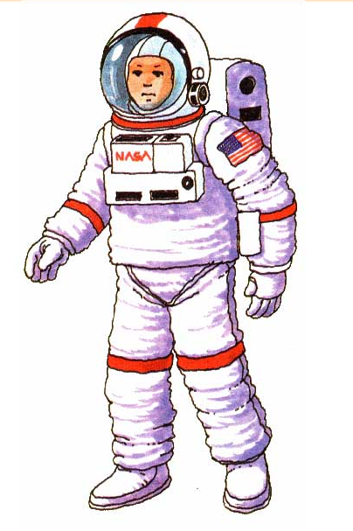
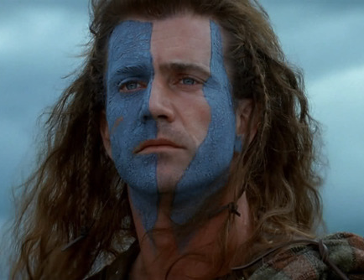
Who are they?

